Slide 1
External Review of the Board Approved Reforms to the Inspection Panel Toolkit and Creation of the World Bank Accountability Mechanism
July 2024

Slide 2
What were the Toolkit Reforms to IPN? (approved by the WB Board 2018 and 2020)
Recognize the Inspection Panel‘s Advisory Role
Provide clarification on Bank Executed Trust Funds
Formalize the IPN coordination with IAMs of co-financiers
Establish procedures on sharing IPN investigation reports with requesters
Extend the time limit under which requesters can file a complaint by fifteen months beyond Bank project closure
Allow IPN (with GIA input) to propose verification of MAP implementation to the Board in accordance with criteria laid out in Framework for Risk Based Proportionality Criteria
Offer a dispute resolution process as an alternative to a compliance review
Establish a new Accountability Mechanism housing the IPN and the Dispute Resolution Function
2

Slide 3
Focus of the Review
The External Review is not a comprehensive review of IPN and AM Policy as conducted by other IAMs at periodic intervals. The Toolkit Reform provided for a Review after three years to be able to make midcourse adjustments to reforms adopted in 2018 and 2020, if needed.
The TOR lays out specific review questions which the External Review Team (ERT) closely followed in conducting its review and making recommendations.

Slide 4
Structure of Presentation
1. Accessibility
2. Dispute Resolution
3. Verification Mandate
4. Structure and Independence of Inspection Panel
5. Communications and Outreach
6. Conflicts of Interest

Slide 5
1. Access to Compliance and DR TOR question: Are the compliance and dispute resolution function accessible to Parties?
Number of requests filed with AM/IPN are low, amounting to only 0.8 percent of approved projects over the last 10-year period.
Access criteria as laid out in the IPN Resolution and Operating Procedures are complex, difficult to understand and partly contradictory.
Recommendation: IPN Resolution and Operating Procedures should be revised to lay out clear and simple access criteria.
Registration criteria should be simple and predictable so that affected people understand them.
Eligibility assessment criteria should be more demanding.

Slide 6
IPN should have right to self-initiate an Eligibility Assessment
Affected people are often unwilling to file a request. The IPN should be given the right to self-initiate an eligibility assessment in case of:
Concerns exist regarding particularly severe harm;
and/or
Project-affected people may be subject to or fear reprisals, preventing them from lodging a complaint;
and/or
The need to review environmental and/or social compliance issues of systemic importance to the World Bank.

Slide 7
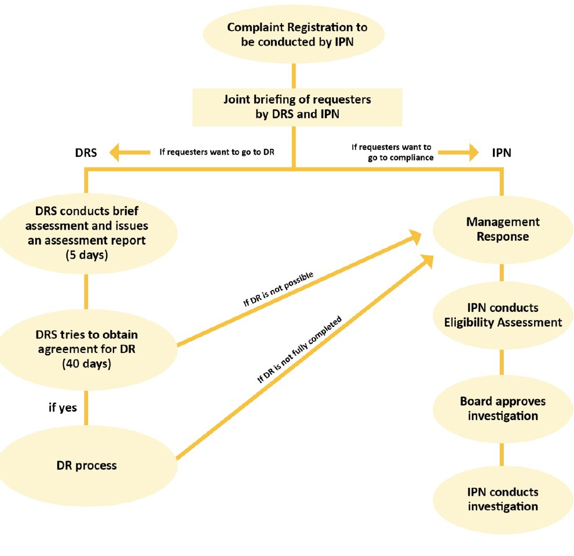
Recommendation: Earlier and Easier Access to DR
If requesters desire access to DR, this could take place after registration
DRS would conduct a short assessment to determine whether the request is suitable for DR
If yes, DRS will explore whether both parties agree to DR
If yes, DR process will be conducted
If no, request will be transferred to the compliance process

Slide 8
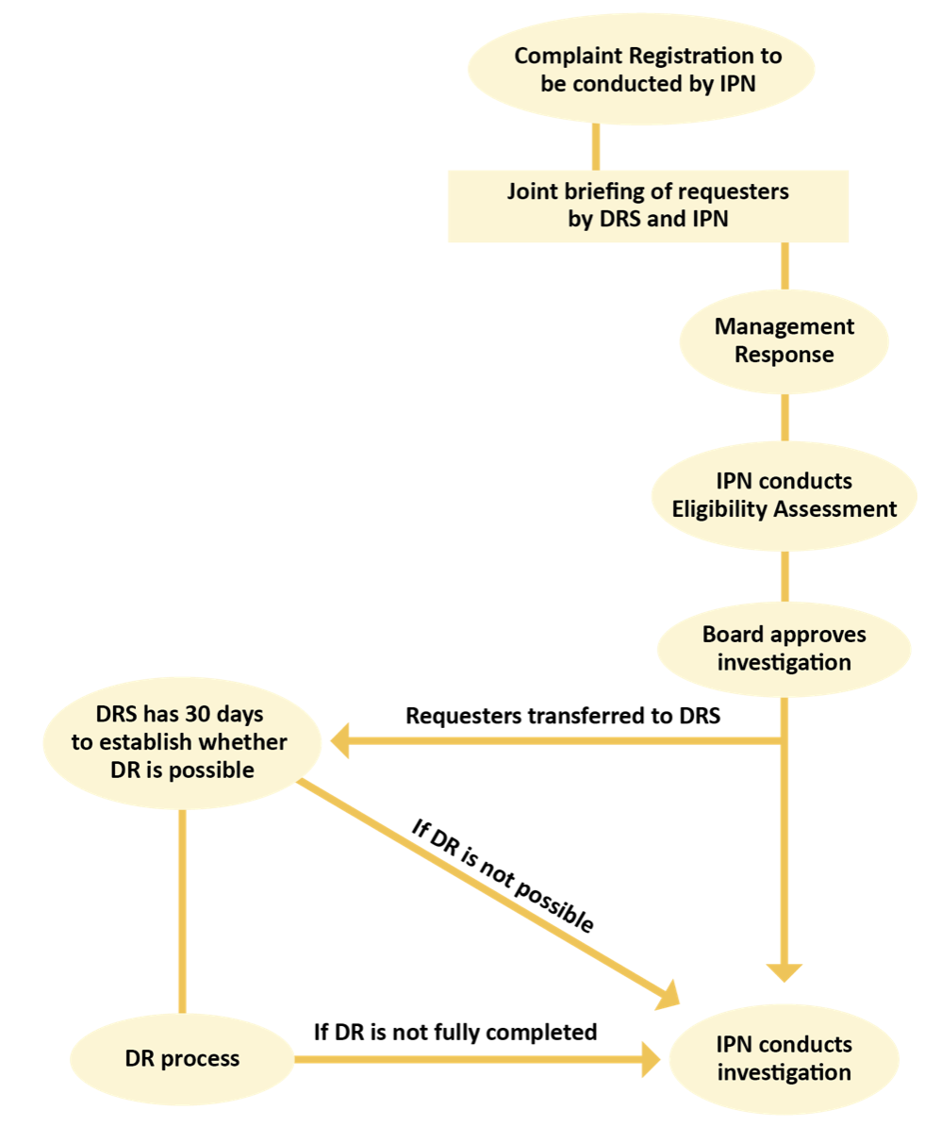
Present Access to DR
Access to DR comes late– in most cases 3.5 months after registration of request.
Access is embedded into compliance access which focuses on noncompliance with Bank policy.
Noncompliance with Bank policies is not the subject of the DR process.

Slide 9
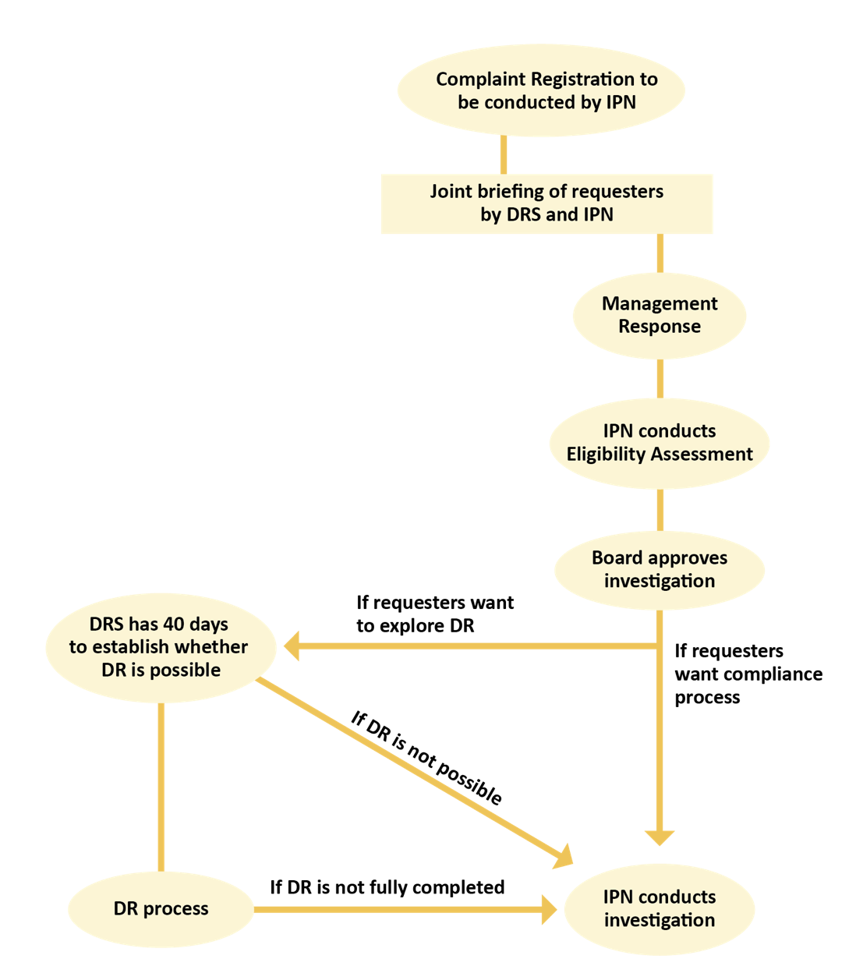
If Early Access is not adopted, then Adjustment for Requester Choice is essential
DRS would ask requesters after approval for investigation whether they wish to pursue DR, as now provided.
If the answer is no, the request proceeds without interruption to compliance investigation and no offer of DR would be made to the other party.
Requesters who wish to explore DR would be transferred to DRS for 40 days to establish whether DR is possible.

Slide 10
Some requests should only be pursued through a Compliance process
Requests which allege severe long term structural harm, typically environmental harm, should not be processed through DR as harm affects many more people than those participating in the DR process.
Requests which allege severe gender-based violence and physical violence require public accountability which is better provided through a compliance process.

Slide 11
2. Dispute Resolution within the Present AM Structure
TOR question: Does the current AM institutional Structure enable the DRS to facilitate a voluntary and independent dispute resolution option for requesters and borrowers in the context of Inspection Panel Requests for Inspection?
Dispute Resolution was only established in 2021.
DR has quickly built up a portfolio: 4 out of 7 complaints approved for a compliance investigation since 2021 have proceeded to DR. In 3 of these cases, DR has been completed.
It appears that DR can function within the present AM structure. ERT makes recommendations on interaction points between DR and the compliance process.

Slide 12
More Disclosure in DR to Improve Public Accountability
For all DR cases so far completed, confidentiality for the DR agreement was requested and disclosure of information by AM was very limited.
DR is a function of a public accountability mechanism and more comprehensive reporting is needed. Operating policies lay out reporting principles for DRS which should also be applied for confidential cases. The DR agreement itself does not need to be disclosed.
.

Slide 13
External Review of DRS in 24 Months
DR has had a good start but is still a new function that needs to establish itself as a trusted and predictable function which creates a level playing field between parties.
The ERT recommends an external review of the DR function in 24 months after further DR processes have been completed and monitoring of agreements conducted.

Slide 14
3. Verification Mandate for IPN and GIA
TOR question: How does the current framework for independent verification of Management Action Plans compare with other IAMs? Are the thresholds for triggering independent verification by IPN and GIA appropriate?
The IPN has a verification mandate which is significantly more limited than any other IAM/MBD (with the exception of AIIB).
The verification role assigned to GIA is unique among IAMs
The Toolkit Reforms gave the IPN (with GIA input) the right to recommend verification to the Board for approval. Recommendations are narrowly restricted through the Framework for Proportionality Criteria and Modalities for Independent Verification of Management Action Plan Implementation.
The ERT finds this Framework complex, unnecessarily prescriptive, and the criteria and weighting scheme somewhat arbitrary. IPN should be given a broader verification mandate.

Slide 15
Recommendations for Verification
Options range from modest to significant change.
Option 1: Full verification mandate, in line with other IAMs and aligned with CAO
Option 2: IPN to make recommendation for selected projects to the Board at time when MAPs are considered for approval. IPN is not bound by Framework for Proportionality but can use some requester related criteria as guiding principles.
Option 3: Maintain present system but introduce a process where requesters and representatives can record disagreements with MAP update report posted on IPN website.

Slide 16
4. Structure and IPN Independence TOR question: Does the current AM structure enable IPN to continue to carry out its compliance functions independently?
Although the intent of AM’s structure was to preserve IPN’s independence while creating an efficient organizational design, the AM structure is unique and complicated.
AMSec heads AM, but it is not a pyramid.
IPN and DRS are in the same unit with strong boundaries keeping them separate (IPN independence and firewalls).
AMSec heads both AM and DRS which poses a potential conflict of interest.
Findings:
IPN’s independence in performing its compliance functions has not been significantly affected to date by being in a structure where it does not control its resources and finances, but the potential for impact does exist and the current structure does make work processes less efficient.
IPN has experienced increased tensions and scheduling problems during compliance reviews as a result of the AM and IPN Resolutions’ requirement to offer DR to both parties even when requesters do not want DR.

Slide 17
Structure Recommendations
Retain the three-member Inspection Panel that:
Reports directly to the Board
Has operational and administrative independence
Has a minimum 2-year term for the Chair role
Make changes to structure and Resolutions to address contradictions, ambiguities, and conflicting interpretations. Four options are presented.
Options range from moderate to significant change.
Three options reflect continuation of IPN
One option is provided in the event a decision is made not to retain IPN
Establish stronger governance processes to systematically measure and report to the Board on DRS and IPN effectiveness, efficiency and costs.

Slide 18
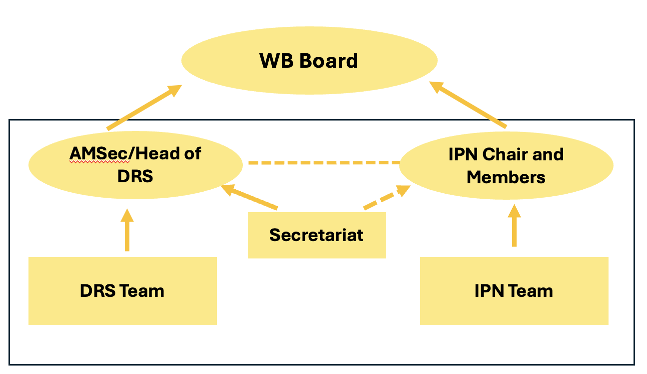
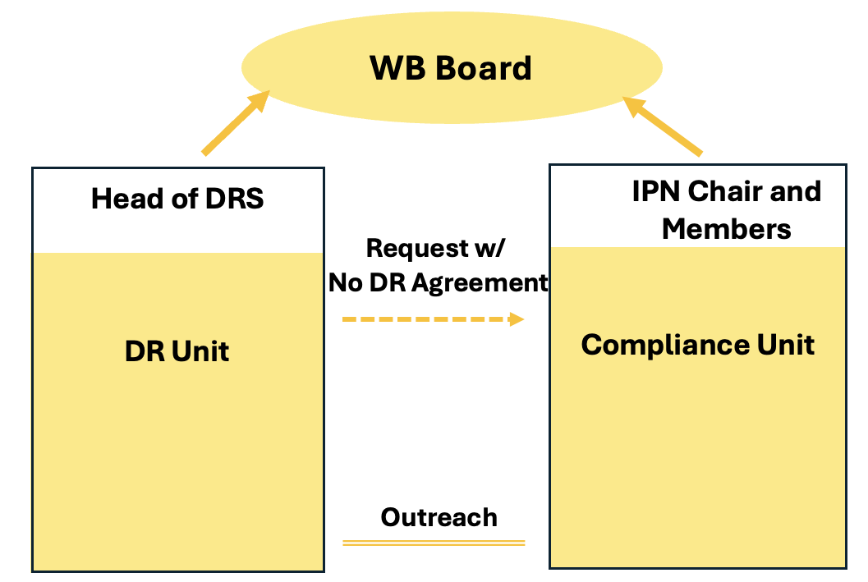
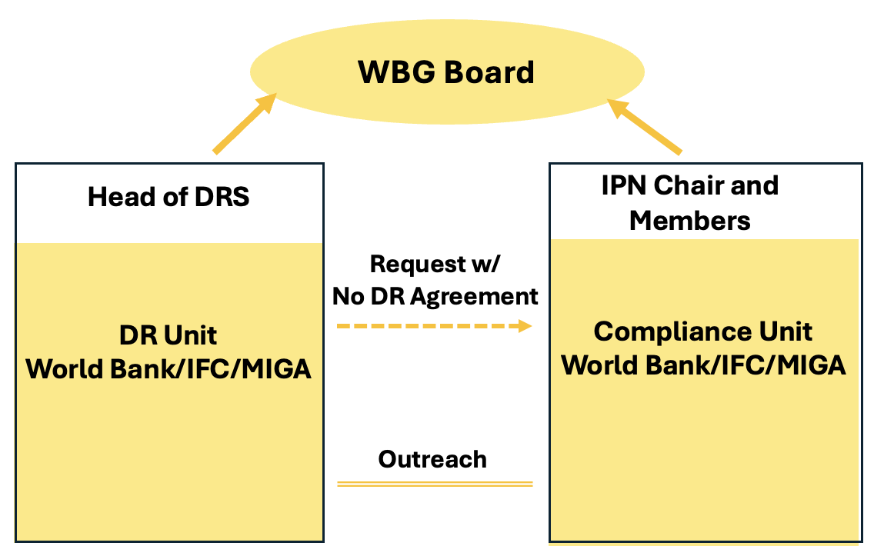
Variation of Present Structure
Structure Options with Panel
I
II
III
Two Completely Separate Functions
Mergers with CAO function
Transfer management of human and financial resources back to IPN, and narrowly define firewalls.
Magnitude of Change Required
Priority Objectives:
Support continuity, minimal change
Support easier DR access and reduce intersections that cause conflict
Support “One World Bank,” consistent structure for all WBG independent units, and economies of scale

Slide 19
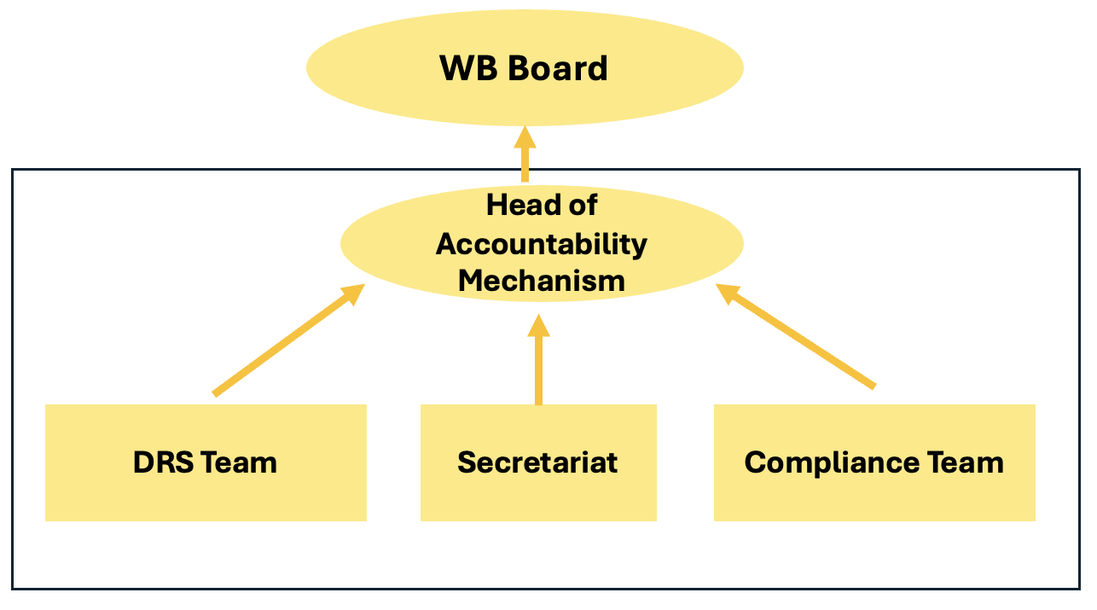
A Pyramid Structure
Structure Option without Panel
IV
Priority Objectives:
Efficiency, cohesiveness, and synergy in AM, and determination that an independent Inspection Panel is no longer needed.

Slide 20
5. Communications and Outreach
TOR question: Have the AMSec/Head of DRS and IPN been able to effectively disseminate information on the new structure, processes, workflow, and outcomes to different stakeholders?
What are the strengths and weaknesses?
Findings:
Both AMSec and IPN have implemented active outreach efforts to inform a wide range of international and local stakeholders on the 2020 Toolkit Reforms and the creation of the new AM structure.
This includes partnering with other IAMs, CSOs, and, in some cases AMSec has internally partnered with World Bank External Communications and Relations and Country Offices.
Coordination of IPN and AM communications could be strengthened.
Outreach by borrowers, project teams and country offices needs to be strengthened.
Recommendations:
If IPN is retained, the Bank should continue to take advantage of IPN’s brand, while also ensuring consistent messaging across the Bank’s accountability mechanism.
Post information about IPN/AM on country websites and prominently in initial project information and appraisal documents, and project teams make special efforts to provide information to project-affected people directly and through project entities.

Slide 21
6. Conflict of Interest TOR question: Does the current model of World Bank’s Accountability Mechanism pose any actual or perceived conflicts of interests to the staff involved in various functions, e.g. including with respect to maintaining the firewall between IPN and DRS, internal communication, human resource management and finance decisions, work programming, and office arrangements?
Findings:
The potential for conflict of interest exists when:
The AMSec/Head of DRS makes decisions on human or financial resources that benefit DRS to the detriment of IPN. While this potential exists, it has not occurred.
IPN’s early engagement with requesters creates requester bias toward a compliance review. Given 4 of 7 cases approved for investigation have selected a DR process, this bias is not evident.
Both parties are offered the DR option even when requesters do not want to pursue DR. Given this practice increases harm to and intimidation of requesters, it is in conflict with the interest of requesters.
Firewalls are applied beyond protecting the interests of borrowers and requesters to inhibit information sharing that hinders other AM component work efforts, which is in conflict with the interests of AM operations and its governance.
Recommendations:
Only offer the DR option to borrowers if requesters have first expressed an interest in pursuing that option.
Ensure that the process for returning unresolved issues from the DR process to IPN for a compliance review is prominently explained on AM and IPN websites, brochures and other information materials.
Modify AM Resolution and internal protocol to explicitly clarify purpose of firewalls and transfer control of human and financial resources back to IPN.

